Slide 1
Thermal evaluation of Multi-Chip Modules(MCM)
4. Resistance Network Methodology
This technique is extremely useful for effective thermal resistance characterization of thermal models of Multi-Chip modules(Lateral and stacked die package). It can also be used to verify the computer models.
Concept is extracted from the reference articles

Slide 2
Thermal evaluation of Multi-Chip Modules(MCM)
Clearly, Resistance Network Methodology breaks down the thermal issues when dealing with an MCM. First, it only accounts for a single junction temperature. Second, even when the power applied to one chip is zero, T_{J,REF} can be non-zero due to power applied to another chip in the package. Applying Equation 1 to the non-powered chip would involve dividing a finite value of T_{J,REF} by zero power. This would lead to a value of infinity for Theta _{J,REF} – not a very useful result.
Intuition tells us that the temperature of any chip in an MCM would be affected by the particular combination of power levels applied to all the chips. This, clearly, represents a much more complicated situation than encountered with single-chip packages. The following discussion deals with two basic types of MCMs and provides some relatively simple means of dealing with them.
i.e The fundamental effect that differentiates these devices from the single chip package is that each chip heats the adjacent chips and relative heat dissipation of the chips may vary depending on the device operation

Slide 3
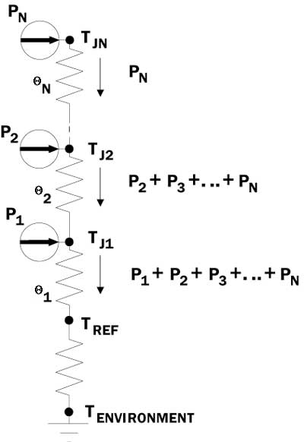
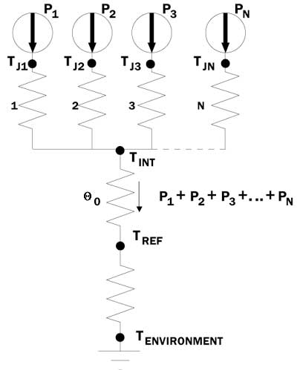
Thermal evaluation of Multi-Chip Modules(MCM)
Basic approach to MCM analysis(Thermal Resister Network)
Fig 2. MCM-Lateral chip configuration
Fig 3. MCM-Stacked chip configuration

